Slide 1
Linear Algebra
Vector Operations

Slide 2
Outline
Scalar Multiplication
Vector Addition
Vector Subtraction
Vector Addition and Multiplication Together

Slide 3
Scalar Multiplication
Scalar multiplication: a scalar times a vector
Multiply each element of the vector by the scalar
$$3 ∗ \left[−1 2 5\right]=\left[−1∗3 2∗3 5∗3\right]=[−3 6 15]$$
$$\frac{1}{2} ∗ \left[−1 2 5\right]=\left[−1∗\frac{1}{2} 2∗\frac{1}{2} 5∗\frac{1}{2}\right]=[−\frac{1}{2} 1 \frac{5}{2}]$$
$$−2 ∗ \left[−1 2 5\right]=\left[−1∗−2 2∗−2 5∗−2\right]=[2 −4 −10]$$

Slide 4
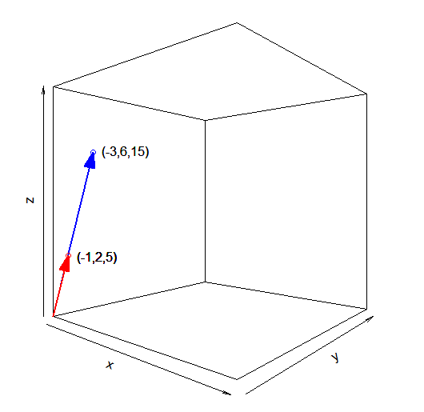
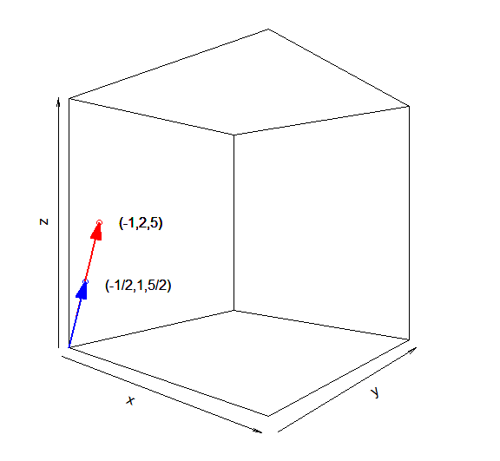

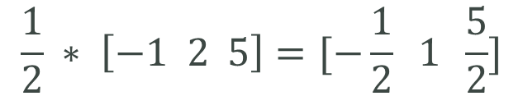
Scalar Multiplication
The original vector is being dilated – stretched or compressed – by a factor equal to the scalar
$$\frac{1}{2} ∗ \left[−1 2 5\right]=[−\frac{1}{2} 1 \frac{5}{2}]$$
$$3 ∗ \left[−1 2 5\right]=[−3 6 15]$$

Slide 5

Vector Addition
Vector Addition: adding two vectors
Both vectors must have exactly the same dimensions
Add element-wise
$$\left[ 2 3 \right]+\left[ 1 4 \right]=\left[ 2+1 3+4\right]=[ 3 7 ]$$
$$\left[\begin{matrix}3 \\ 5 \\ 1\end{matrix}\right]+\left[\begin{matrix}2 \\ 4 \\ 0\end{matrix}\right]=\left[\begin{matrix}3+2 \\ 5+4 \\ 1+0\end{matrix}\right]=\left[\begin{matrix}5 \\ 9 \\ 1\end{matrix}\right]$$

Slide 6
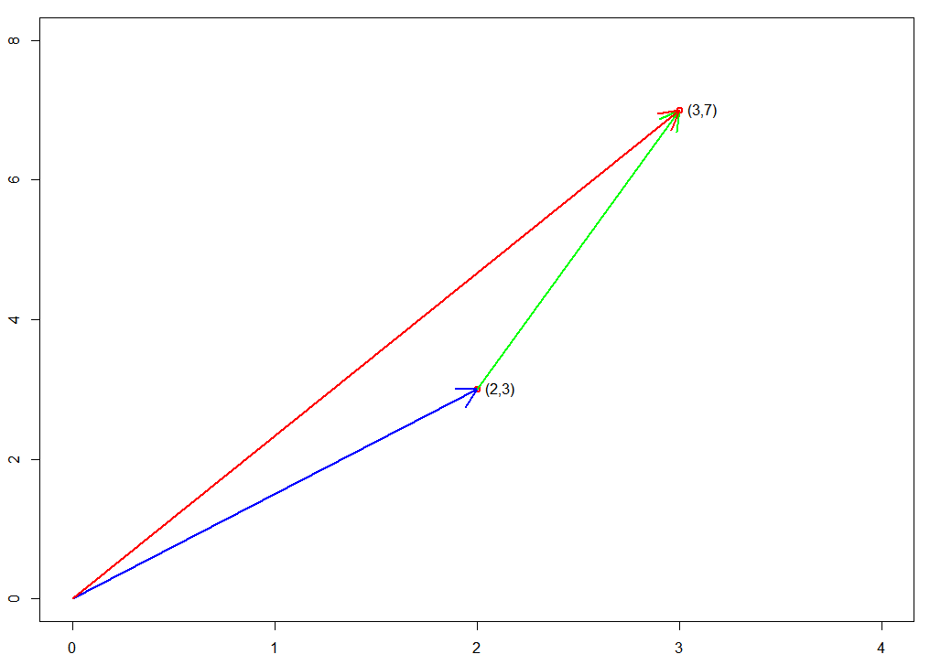
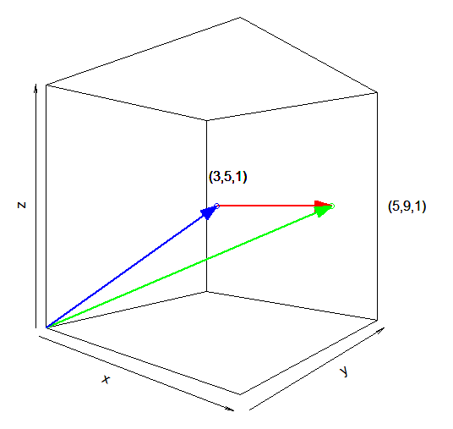

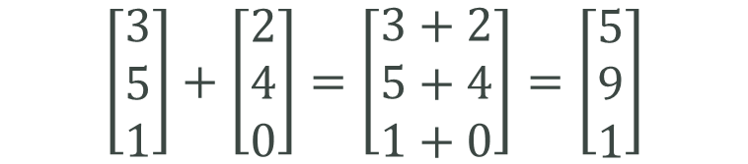
Vector Addition
The second vector is being drawn from the end of the first to create a new vector
$$\left[\begin{matrix}3 \\ 5 \\ 1\end{matrix}\right]+\left[\begin{matrix}2 \\ 4 \\ 0\end{matrix}\right]=\left[\begin{matrix}3+2 \\ 5+4 \\ 1+0\end{matrix}\right]=\left[\begin{matrix}5 \\ 9 \\ 1\end{matrix}\right]$$
$$\left[ 2 3 \right]+\left[ 1 4 \right]=[ 3 7 ]$$

Slide 7
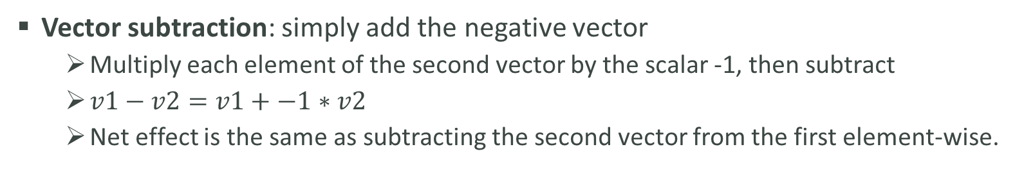
Vector Subtraction
Vector subtraction: simply add the negative vector
Multiply each element of the second vector by the scalar -1, then subtract
$v1−v2=v1+−1∗v2$
Net effect is the same as subtracting the second vector from the first element-wise.
$$\left[ 2 3 \right]−\left[ 1 4 \right]=\left[2 3 \right]+−1∗\left[ 1 4 \right]=\left[ 2 3 \right]+\left[ −1 −4 \right]=[ 1 −1]$$

Slide 8
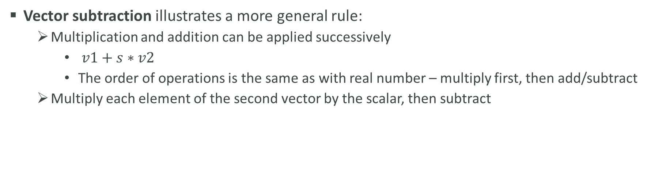
Vector Addition and Multiplication Together
Vector subtraction illustrates a more general rule:
Multiplication and addition can be applied successively
$v1+s∗v2$
The order of operations is the same as with real number – multiply first, then add/subtract
Multiply each element of the second vector by the scalar, then subtract
$$\left[ 2 3 \right]+3∗\left[ 1 4 \right]=\left[2 3 \right]+\left[ 3 12 \right]=[ 5 15 ]$$

